Slide 1
Team: PIXEL
Reg No. 2019042
Team Members
Nikhil K Khaneja
Raunak Bhupal
Kalidindi Lakshmi Sanjana

Slide 2
Idea Summary
Do you trust your card payments?
Do you think the transactions are secure?
NO, IT’S NOT!!!
Here we present you a highly secure and cardless transaction system.
It is a FVR (Finger Vein Recognition) Security System.
NOW YOU CAN FORGET YOUR WALLETS AT HOME!!
TRAVEL CASHLESS AND CARDLESS!

Slide 3
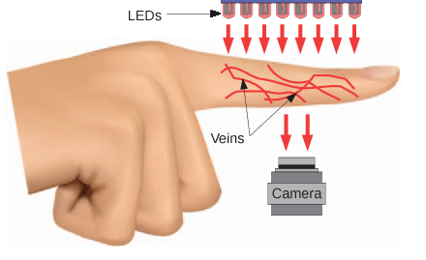
This is how the image is captured

Slide 4
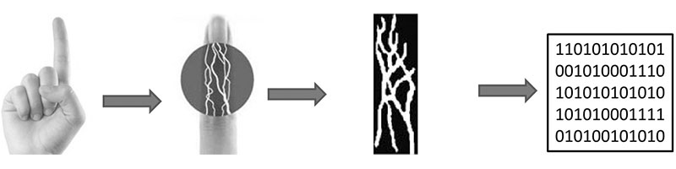

Slide 5
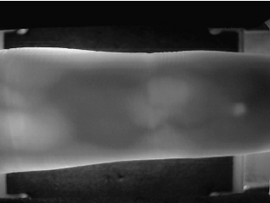

INPUT
OUTPUT

Slide 6
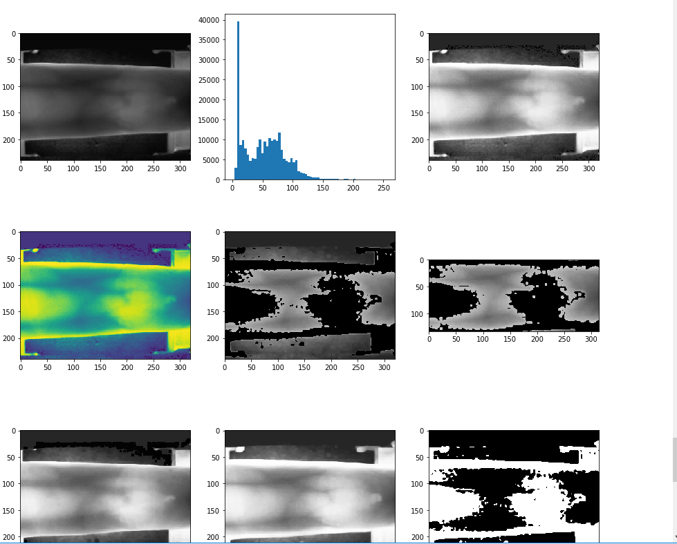

Slide 7
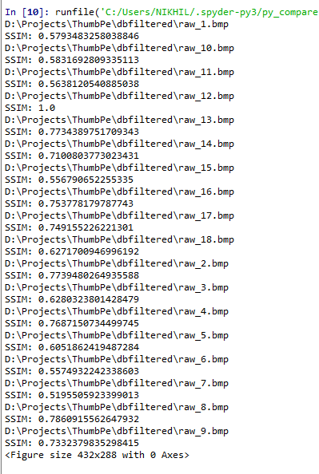

Slide 8
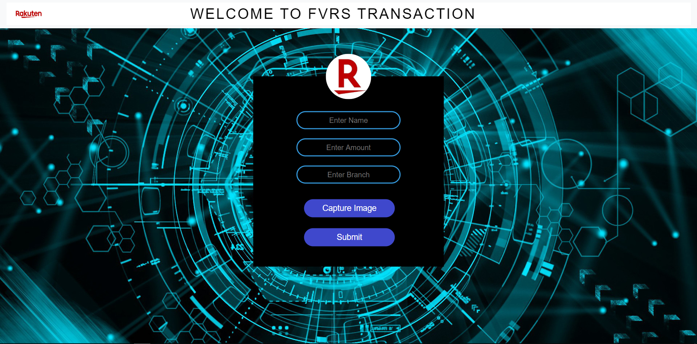

Slide 9
Business Proposition
“The newness effect of a new thing wears off in nine months to a year, but financial security can last a lifetime”. This is why we came up with an idea of Finger Vein Recognition and Authentication system. Just a small machine which allows you to perform highly secured transactions which costs around 5500 rupees and which is portable and can be easily installed ranging from small scale shops to large scale bank locker security system.

Slide 10
Tech Stack / Architecture / API
Python Django
HTML,CSS
BOOTSTRAP

Slide 11
Thank You

